Slide 1
8086
Internal architecture of 8086
Minimum mode
Maximum Mode
Machine Instruction Format
Instruction Set of 8086

Slide 2
Introduction
Intel 4 bit microprocessor 4004 in 1971
8 bit 8008 in 1972
8 bit microprocessor 8080 in 1974 by Intel is the first step towards the development of advanced microprocessors.
8085 8 bit followed 8080
Limitations of 8 bit microprocessors:
  Low speed of execution
  Low memory addressing capabilities.
  Limited number of general purpose registers
  Less powerful instruction set.

Slide 3
8086 in 1978
16 bit microprocessor
Large memory, powerful instruction set
Improved speed.

Slide 4
Architecture of 8086
Register Organization of 8086
16 bit registers
  General purpose registers – can be used as either 8-bit registers or 16 –bit registers.
    Used for holding data, variables and intermediate results (used as counters or for storing offset address for some particular addressing modes etc.)
  Special purpose registers
    Used as segment registers, pointers, index registers, offset storage for particular addressing modes.

Slide 5
General Data registers
  AX,BX,CX,DX- 16 bit registers (X)
  AX---AL and AH
  CX- counters
  BX- offset storage
  DX- implicit operand or destination in few instructions.

Slide 6
Segment registers
1MB memory – is divided to 16 logical segments. Each segment contains 64 KB of memory.
4 Segments- CS, DS, SS, ES
CS register- used to address a memory location in the code segment of the memory- where the executable program is stored.
DS register- used to address memory location where data resides.
ES- also contains data
SS- store stack data

Slide 7
Pointers and Index Registers
Pointers IP,BP,SP usually contains offset within the code, data and stack segments respectively.
Index registers are used a sgeneral purpose registers as well as for offset storage in case of indexed, based indexed and relative based indexed addressing modes.
SI- used to store the offset of source data in data segment
DI used to store offset of destination in data or extra segment. They are usually used for string manipulation.
Flag Registers – indicates the results of computations in ALU and some flag bits to control CPU operations.

Slide 8
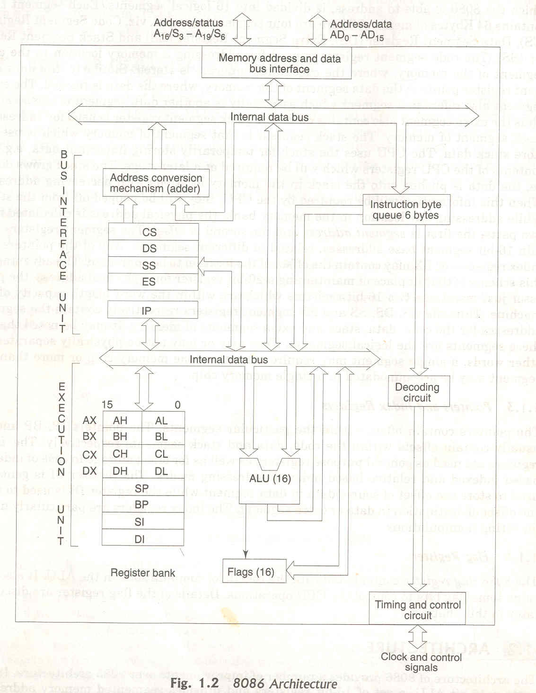

Slide 9
Internal architecture of 8086
Two main parts :
  Bus Interface Unit
  Execution Unit

Slide 10
Functions of Bus Interface Unit
Performing external bus operations
Compute the physical address of 20 bit address
  four segment registers (DS, CS, SS and ES)- base address of the segment (segment address from segment register- 16 bit address)
  IP - Instruction Pointer (offset address available here- 16 bit address)
  Procedure for calculating Physical address
    Segment address shifted 4 times bit wise to the left and add it with the 16 bit offset address.

Slide 11
Instruction Byte Queue
Instruction queue is 6 bytes long, FIFO structure.
The instructions from the queue are taken for decoding sequentially.
Once a byte is decoded, the queue is rearranged by pushing it out and the queue status is checked for the possibility of the next opcode fetch cycle.

Slide 12
Instruction pipelining
While the opcode is fetched bus interface unit, the execution unit executes the previously decoded instruction concurrently.
By prefetching the instruction there is a considerable speeding up in instruction execution in 8086. This scheme is known as instruction pipelining.

Slide 13
Execution Unit
Executes the executes the previously decoded instruction.
16 bit ALU performs all arithmetic and logical operations.
16 bit Flags
AX,BX,CX,DX,SI,DI,SP and BP Registers.

Slide 14
General Purpose Registers
All general registers of the 8086 microprocessor can be used for arithmetic and logic operations.
The general registers are:
Accumulator
  Accumulator register consists of two 8-bit registers AL and AH, which can be combined together and used as a 16-bit register AX. AL in this case contains the low-order byte of the word, and AH contains the high-order byte. Accumulator can be used for I/O operations and string manipulation.

Slide 15
Base register
  Base register consists of two 8-bit registers BL and BH, which can be combined together and used as a 16-bit register BX. BL in this case contains the low-order byte of the word, and BH contains the high-order byte. BX register usually contains a data pointer used for based, based indexed or register indirect addressing.

Slide 16
Count register
  Count register consists of two 8-bit registers CL and CH, which can be combined together and used as a 16-bit register CX. When combined, CL register contains the low-order byte of the word, and CH contains the high-order byte. Count register can be used as a counter in string manipulation and shift/rotate instructions.

Slide 17
Data register
  Data register consists of two 8-bit registers DL and DH, which can be combined together and used as a 16-bit register DX. When combined, DL register contains the low-order byte of the word, and DH contains the high-order byte. Data register can be used as a port number in I/O operations. In integer 32-bit multiply and divide instruction the DX register contains high-order word of the initial or resulting number.

Slide 18
General and index registers
Stack Pointer (SP) is a 16-bit register pointing to program stack.
Base Pointer (BP) is a 16-bit register pointing to data in stack segment. BP register is usually used for based, based indexed or register indirect addressing.
Source Index (SI) is a 16-bit register. SI is used for indexed, based indexed and register indirect addressing, as well as a source data addresses in string manipulation instructions.

Slide 19
Destination Index (DI) is a 16-bit register. DI is used for indexed, based indexed and register indirect addressing, as well as a destination data addresses in string manipulation instructions.
Other registers:
Instruction Pointer (IP) is a 16-bit register.

Slide 20
Flags
Overflow Flag (OF) - set if the result is too large positive number, or is too small negative number to fit into destination operand.
Direction Flag (DF) - if set then string manipulation instructions will auto-decrement index registers. If cleared then the index registers will be auto-incremented.
Interrupt-enable Flag (IF) - setting this bit enables maskable interrupts.

Slide 21
Single-step Flag (TF) - if set then single-step interrupt will occur after the next instruction.
Sign Flag (SF) - set if the most significant bit of the result is set.
Zero Flag (ZF) - set if the result is zero.
Auxiliary carry Flag (AF) - set if there was a carry from or borrow to bits 0-3 in the AL register.
Parity Flag (PF) - set if parity (the number of "1" bits) in the low-order byte of the result is even.
Carry Flag (CF) - set if there was a carry from or borrow to the most significant bit during last result calculation.

Slide 22
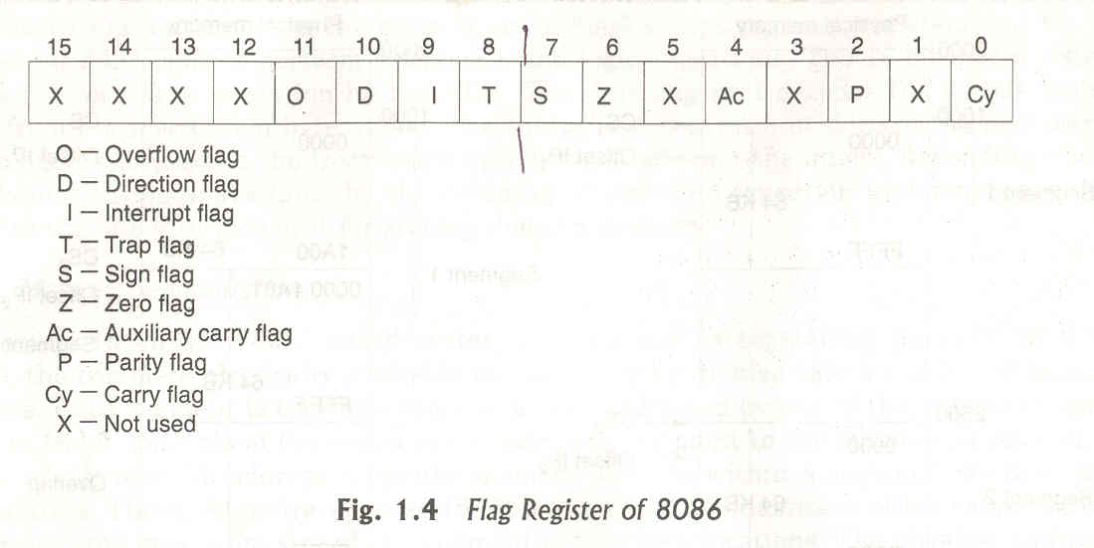
Flags

Slide 23
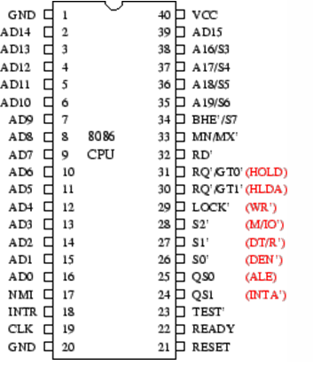
Pin diagram of 8086

Slide 24
Memory Segmentation
Segmented memory
Physically available memory may be divided into a number of logical segments. Each segment 64KB in size addressed by one of the segment registers.
CPU is able to address 1MB of physical memory. 16 segments out of 1 MB. Each segment of 64 KB size.
Non- Overlapping Segments- Address of the Segments (0000-F000H) and offset (0000-FFFFh) so physical address ranges from 00000-fffffh
Overlapped Segments.

Slide 25
Advantages of Segmented memory
Allows memory capacity to be 1MB although the actual addresses to be handled are of 16 bit size.
Allows placing of code, data and stack portions of the same program in different segments of memory for data and code protection.
Permits program or its data to be put into different areas of memory each time program is executed. Ie. Provision for relocation may be done.

Slide 26
8086 signals can be classified into three groups:
Signals having common function in both minimum mode and the maximum mode.
Signals having special function for the minimum mode.
Signal having special functions for the maximum mode.

Slide 27
Signals having common function in both minimum and maximum mode
AD₁₅-AD₀ :
  These are time multiplexed address and data lines.
  Address remains in the line during T1 state and data is available in the data bus during T2,T3,Tw and T4.
  These lines are active high.

Slide 28
A₁₉/S₆, A₁₈/S₅, A₁₇/S₄, A₁₆/S₃:
  These are time multiplexed data lines and status lines.
  During I/O operations, these lines are low.
  The S₄ and S₃ combined, indicate which segment registers is being currently used for memory access.
  These are also tri-state lines.
  The status line S₆ is always low.
  The address bits are separated from the status bits using latches controlled by the ALE signal.

Slide 29
BHE’/ S₇₋Bus High Enable Status:
  It is used to indicate the transfer of data over the higher order(D₁₅-D₈).
  It goes low for the data transfers over D₁₅ and D₈ used to derive chip selects of odd address memory bank or peripherals.
  The signal is low and tri-stated during the hold state.
BHE’ | A0 | Indication
0 | 0 | Whole word
0 | 1 | Upper byte from or to odd address
1 | 0 | Lower byte from or to even address
1 | 1 | None

Slide 30
RD’-Read:
  This signal, when low, indicates the peripherals that the processor is performing a memory or I/O read operation.
  It is an active low signal.
  This signal remains tri-stated during the hold acknowledge.
READY:
  This is the acknowledgement from the slow devices or the memory that they have completed the data transfer.
  This is an active high signal.

Slide 31
INTR-Interrupt Request:
  This is a level triggered input.
  This is sampled during the last clock cycle of each instruction to determine the availability of the request.
  If any interrupt request is pending, the processor enters the interrupt acknowledge cycle.
  This signal is active high and internally synchronized.
TEST’:
  This input is examined by a WAIT instruction.
  If this signal goes low, execution will continue. Otherwise the processor remains in an idle state.

Slide 32
NMI-Non Maskable Interrupt:
  This is an edge triggered input which causes a type2 interrupt.
  The NMI is not maskable internally by software.
  This input is internally synchronized.
RESET:
  This input causes the processor to terminate the current activity and start execution from FFFF0H.
  This signal is active high and must be active for at least four clock cycles.
  It restarts execution when the RESET returns low.
  RESET is also internally synchronized.

Slide 33
CLK-Clock:
  The clock input provides the basic timing for processor operation and bus control activity.
  It is an asymmetric square wave with 33% duty cycle.
  The range of frequencies for different versions of 8086 varies from 5MHz to 10MHz.
Vcc:
  +5V power supply for the operation of the internal circuit.
GND:
  Ground for the internal circuit.
MN/MX:
  The logic level of this pin decides whether the processor has to work in the minimum mode (single processor) or the maximum mode (multi processor).

Slide 34
The following pin functions are for the minimum mode operation of 8086:
M/I/O’:
  This is a status line logically equivalent to S₂’ in the maximum mode.
  When it is low, it indicates that the CPU is having an I/O operation and when it is high, it indicates that the CPU is having a memory operation.
INTA’-Interrupt Acknowledge:
  This signal is used as read strobe for interrupt acknowledge cycles.
  When it goes low, the processor has accepted an interrupt.
  It invites the interrupting device to place the incoming vector on to the data line.

Slide 35
ALE-Address Latch Enable:
  This is an output signal.
  It indicates the availability of a valid address on the address/data line.
  It is connected to the latch enable input of latches.
  The signal is active is active high and is never tri-stated.
DT/R’-Data Transmit/Receive:
  This is used to determine the direction of data flow the trans-receivers.
  When the processor sends out data, the signal is high and when the processor is receiving data, the signal is low.
  It is tri-stated during the hold acknowledge.
  Logically, this signal is equivalent to S₁’ in maximum mode.

Slide 36
DEN’-Data Enable:
  This signal indicates the availability of valid data over the address/data lines.
  It is used to enable the trans-receivers to separate the data from the multiplexed address/data signal.
  This signal is tri-stated during the hold acknowledge cycle.
HOLD/HLDA-Hold/Hold Acknowledge:
  When the HOLD line goes high, it indicates to the processor that, another master is requesting the bus access.
  The processor, after receiving the HOLD request, issues the hold acknowledge signal on HLDA pin.
  When the processor finds that the HOLD line is low, it lowers the HLDA signal.
  HOLD is an asynchronous input and should be externally synchronized.

Slide 37
Following are the signals applicable for the maximum mode operation of 8086:
S2’, S1’, S0’-Status Lines:
  These are status lines which reflect the type of operation, being carried out by the processor.
S2’ | S1’ | S0’ | Indication
0 | 0 | 0 | Interrupt Acknowledge
0 | 0 | 1 | Read I/O port
0 | 1 | 0 | Write I/O port
0 | 1 | 1 | Halt
1 | 0 | 0 | Code Access
1 | 0 | 1 | Read Memory
1 | 1 | 0 | Write Memory
1 | 1 | 1 | Passive

Slide 38
LOCK’:
  This is an active low signal.
  This pin indicates that other system bus masters will be prevented from gaining the system bus, while the LOCK’ signal is low.
  This pin is activated by the LOCK prefix instruction and remains active until the completion of the next instruction.
QS₁, QS₀-Queue Status:
  These lines give information about the status of the code pre-fetch queue.
  These are active during clock cycle after which the queue operation is performed.

Slide 39
Q S1 | QS0 | Indication
0 | 0 | No operation
0 | 1 | First byte of opcode from the queue
1 | 0 | Empty queue
1 | 1 | Subsequent byte from the queue

Slide 40
RQ’/GT₀’, RQ’/GT₁’-Request/Grant:
  These pins are used by other local bus masters, in maximum mode to force the processor to release the local bus at the end of the processor’s current bus cycle.
  Each of the pin is bi-directional with RQ’/GT₀’ having higher priority than RQ’/GT₁’.

Slide 41
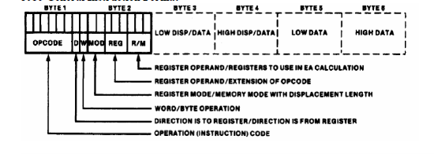
Machine language instruction formats
Opcode field | Operands filed

Slide 42
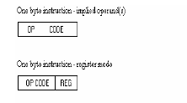
W=0; byte
W=1 ;word
1 byte instruction opcode and last three bits for specifying register operand or opcode and operand implied in it.
D7 D1 | D0
Opcode | W

Slide 43
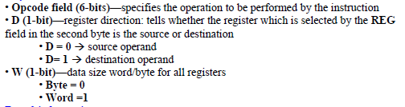

Slide 44
Register to Register-2 bytes long
Opcode | W |  | 11 | REG | R/M
The register represented by REG field is one of the operands. The R/M field specifies the other operand field, register or memory location.
11- Register mode with no displacement.

Slide 45

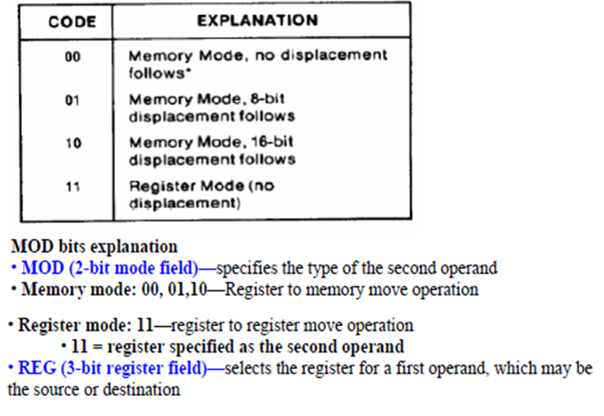

Slide 46
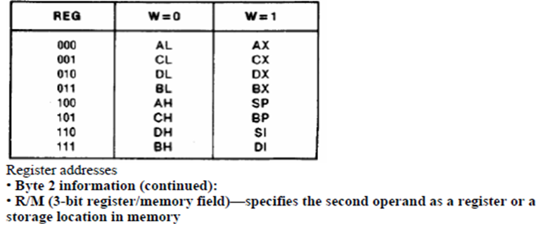

Slide 47
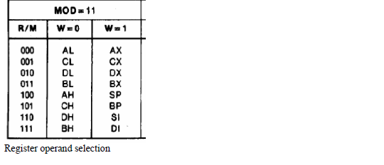

Slide 48
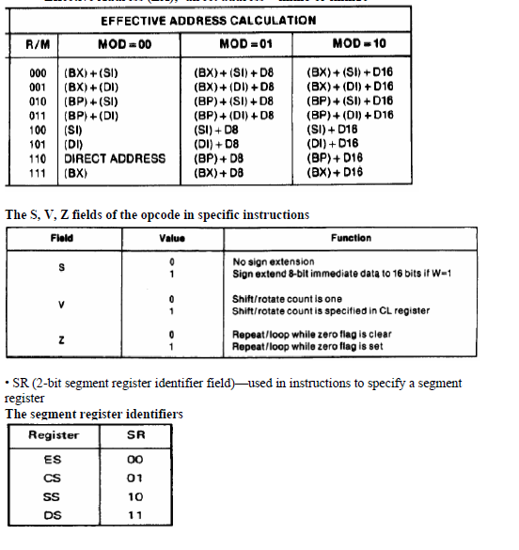

Slide 49
Register to/from Memory with no displacement
D7 D1 D0 D7D6 D5D4D3D2D1D0
Mod=00
Opcode | W |  | MOD | REG | R/M

Slide 50


Register to/from Memory with Displacement
D₇ D₀ D₇ D₀
Immediate operand to register
Low byte of displacement
High byte of displacement

Slide 51
Immediate operand to memory with 16-bit displacement
OPCODE
MOD | OPCODE | R/M
Lower Displacement Byte
Higher Displacement Byte
Lower Byte Data
Higher Byte Data

Slide 52
Example
MOV BL,AL;
Opcode for MOV=100010
Encoding AL so
  D=0 (Al source operand)
W bit=0 (8 bits)
MOD=11 (register mode)
REG=000 (code for AL)
R/M=011
100010 0 0 11 000 011 =88C3 h

Slide 53
Addressing modes of 8086
Addressing mode indicates a way of locating data or operands.
It describes the types of operands and the way they are accessed for executing an instruction.
Sequential control flow instructions and Control transfer instructions.

Slide 54
Addressing modes of 8086
Sequential control flow instructions are the instructions which after execution, transfer control to the next instruction appearing immediately after it in the program.
Control transfer instructions, transfer control to some predefined address or the address somehow specified in the instruction, after their execution.

Slide 55
Addressing modes of 8086
Sequential Control transfer
  Immediate
  Direct
  Register
  Register Indirect
  Indexed
  Register Relative
  Based Indexed
  Relative Based Indexed

Slide 56
Immediate
Immediate data is a part of instruction
  MOV AX,0005H
  Data =0005H can be 8 bit or 16 bit
Direct
  MOV AX,[5000H]
    Data resides in a memory location in the data segment, whose effective address may be calculated using 5000H as the offset address and content of DS as segment address. 10H *DS+5000H

Slide 57
Register Addressing mode
  Data is stored in a register and is referred using a particular register.
  IP cannot be used in this.
  MOV BX,AX;
Register Indirect
  The address of the memory location that contains data or operand is determined by in an indirect way using the offset registers. This mode of addressing mode is known as register indirect addressing mode.
  The offset address of data is in either BX or SI or DI
  The default segment register is either DS or ES.
e.g. MOV AL, [BX];

Slide 58
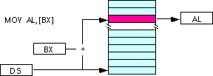


The data is present in a memory location in DS whose offset is in BX. The effective address is
Indexed Addressing Modes
  offset of the operand is stored in one of the index registers.
  DS and ES are the default segments for index registers SI and DI respectively.
  MOV AX,[SI];
  The effective address of the data is

Slide 59


Register Relative
  The data is available at an effective address formed by adding an 8-bit or 16-bit displacement with the content of any one of the registers BX, BP, SI and DI in the default either DS or ES segment.
  e.g. MOV AX, 50H [BX];
  The effective address of the data is
Based Indexed
  The effective address of the data is formed by adding the content of a base register (any one of BX or BP) to the content of an index register (any one of SI or DI). The default segment register may be ES or DS.
  MOV AX,[BX][SI];
  The effective address is

Slide 60


Relative Based Indexed
  The effective address is formed by adding an 8-bit or 16-bit displacement with the sum of contents of any one of the base register (BX or BP) and any one of the index registers in a default segment.
  MOV AX, 50H
  Here 50H is an immediate displacement. The effective address is

Slide 61
Control Transfer Instruction
  Intrasegment Mode
    Intrasegment Direct
    Intrasegment Indirect
  Intersegment Mode
    Intersegment Direct
    Intersegment Indirect

Slide 62
If the location to which control is to be transferred lies in a different segment other than the current one, the mode is called intersegment mode.
If the destination location lies in the same segment, the mode is called intrasegment mode.

Slide 63
Intrasegment Mode
The address to which the control is to be transferred lies in the same segment in which the control transfer instruction lies and appears directly in the instruction as an immediate displacement value.
If the signed displacement (d) is of 8 bits – short jump and if it is of 16 bit it is long jump.

Slide 64
Intrasegment Indirect Mode
The displacement to which the control is to be transferred, is in the same segment in which the control transfer instruction lies, but it is passed to the instruction indirectly.
Branch address is found as the content of a register or a memory location.

Slide 65
Intersegment Direct
  Address to which the control is to be transferred is in a different segment.
Intersegment Indirect
  Address to which the control is to be transferred lies in a different segment and it is passed to the instruction indirectly.

Slide 66
Offset= 5000H
[AX]=1000H,[BX]=2000H,[SI]=3000H,[DI]=4000H,[BP]=5000H,[SP]=6000H,[CS]=0000H,[DS]=1000H,[SS]=2000H,[IP]=7000H
Direct addressing mode
  MOV Ax,[5000H]; EA=15000H
Register Indirect
  MOV AX,[BX]; EA=12000H
Register Relative
  MOV AX,5000[BX]; EA=17000H

Slide 67
Based Indexed
  Mov AX,[BX][SI]; EA=15000H
Relative Based Indexed
  MOV AX,5000,[BX][SI]; EA= 1A000

Slide 68
Instruction Set of 8086
Data Copy/Transfer Instructions
Arithmetic and Logical Instructions
Branch Instructions
Loop Instructions
Machine Control Instructions.
Flag Manipulation Instructions
Shift and Rotate Instructions
String Instructions

Slide 69
MOV
MOV-The data is unchanged at the source, but overwrites whatever was previously at the destination.
This data transfer instruction transfers data from one register/memory location to another register/memory location. The source and destination may be a register or a memory location.

Slide 70
In case of immediate addressing mode, a segment register cannot be a destination register.
To load the segment registers with immediate data, one will have to load any general-purpose register with the data and then it will have to be moved to that particular segment register.
MOV AX, 5000H
MOV AX, BX
MOV AX, [SI]
MOV AX, [6000H]
MOV AX, 50H[BX]
MOV DS, 5000H (Not permitted)
  MOV AX, 5000H
  MOV DS, AX

Slide 71
PUSH: Push to Stack
This instruction pushes the contents of the specified register/memory location onto the stack.
The stack pointer is decremented by two, after each execution of the instruction.
The actual current stack-top is always occupied by the previously pushed data. Hence, the push operation decrements SP by two and then stores the two byte contents of the operand onto the stack. The higher byte is pushed first and then the lower byte.
Eg: PUSH AX
PUSH DS
PUSH [5000H] ; Content of location 5000H and 5001H in DS are pushed onto stack.

Slide 72
POP: Pop from stack
POP AX, loads the low byte in the register, increments SP
Loads the high byte, and increments SP again.
The stack pointer is incremented by two. A PUSH followed by a POP restores the stack to its original state. The SP can be moved to BP, and then data can be accessed at SS:BP, since the default segment for BP is SS.
Eg: POP AX
POP DS
POP [5000H]

Slide 73
PUSHF: Push flags to stack
PUSHF pushes the flag register onto the satck; first upper byte and then the lower byte will be pushed onto stack. The SP will be decremented by two for each push operation.
POPF: Pop Flags from Stack
The POPF instruction loads the flag register completely from the word contents of the memory location currently addressed by SP and SS. The SP is incremented by two for each POP operation.
XCHG: Exchange
Instruction exchanges the contents of the specified source and destination operands, which may be registers or one of them may be a memory location.
Exchange of data contents of two memory locations is not permitted.
XCHG [5000H], AX;
XCHG BX;

Slide 74
IN: Input the port
This instruction is used for reading an input port.
The address of the input port may be specified in the instruction directly or indirectly.
DX is the only register allowed to carry the port address.
Eg: IN AL, 0300H ; Reads data from an 8 bit port whose address is 0300H
& stores t in AL.
IN AX ; Reads data from 16-bit port whose address is DX & stores
it in AX.
OUT: Output the to the port
This instruction is used for writing to an output port.
The address of the input port may be specified in the instruction directly or implicitly in DX.
The registers AL and AX are the allowed source addressed operands for 8-bit and 16-bit operations respectively.
Eg: OUT 0300H ;This sends data available in AL to a port whose address is 0300H
OUT AX ; Sends data available in AX to a port whose address is specified implicitly in DX

Slide 75
XLAT:Translate
Translate instruction is used for finding out the codes in case of code conversion problems, using look up table technique.
  MOV AX, SEG TABLE; Address of the segment
  containing look up table
  MOV DS,AX; is transferred to DS
  MOV AL, CODE; Code of the pressed key is
  transferred in AL
  MOV BX, OFFSET TABLE; Offset of the code look up
  table in BX
  XLAT; Find the equivalent code and store in AL

Slide 76
LEA : Load Effective Address
The instruction LEA loads the offset of an operand in the specified register.
For example, label ADR so LEA BX,ADR loads the offset of the label ADR in BX.
LDS/LES: Load Pointer to DS/ES
This instruction loads the DS or ES register and the specified destination register in the instruction with the content of memory location specified as source in the instruction.
Eg: LDS/LES BX, [5000H]

Slide 77
LAHF: Load AH from Lower Byte Of Flag
This instruction loads the AH register with the lower byte of the flag register. This instruction can be used to observe the status of all the condition code flags at a time.
SAHF: Store AH from Lower Byte Of Flag
This instruction sets or resets the condition code flags in the lower byte of the flag register depending upon the corresponding bit positions in AH.

Slide 78
.model small
.data
msg db 'hello$'
.code
mov ax,@data ;the ds is set to datasegment
mov ds,ax
mov dx,offset msg ;ofset of buffer is stored in dx
mov ah,09h ;write string terminated with $
int21h
mov ah,4ch ;exit to dos
int 21h
end

Slide 79
%TITLE "SAMPLE PROGRAM"
.MODEL SMALL
.STACK 100H
.DATA
A DW 2
B DW 5
SUM DW ?
.CODE
MAIN PROC
;initialize DS
MOV AX,@DATA
MOV DS,AX
;add the numbers
MOV AX,A ;AX has A
ADD AX,B ;AX has A+B
MOV SUM,AX ;SUM = A+B ;exit to DOS MOV AX,4C00h
INT 21h
MAIN ENDP
END MAIN

Slide 80
INT interrupt number
Some examples are:
int 21h ; calls DOS service
int 10h ; calls the Video BIOS interrupt
MOV AH,02 ; Function to output a char
MOV DL,"!" ; Character to output
INT 21h ; Call the interrupt to output "!"
MOV AH,04Ch ; Select exit function
MOV AL,00 ; Return 0
INT 21h ; Call the interrupt to exit
To print a message on the screen all you need to do is this:
mov ah,9 ; subroutine number 9
int 21h ; call the interrupt
Hello.asm
To do: ml Hello.asm makes obj file and exe file
To run type the name of exe file Hello

Slide 81
;input a character from keyboard and display the character on the screen
.model small
.stack 100h
.code
start:
mov ah, 1h ; keyboard input subprogram
int 21h ; read character into al
mov dl, al
mov ah, 2h ; display subprogram
int 21h ; display character in dl
mov ax, 4c00h ; return to ms-dos
int 21h
end start

Slide 82
Structure of an assembly language program
Assembly language programs divide roughly into five sections
  header
  equates
  data
  body
  closing
The Header
The header contains various directives which do not produce machine code
Sample header:
%TITLE "Sample Header"
.8086
.model small
.stack 256

Slide 83
.model small ; specify the program model as small
; ie, code, data, stack, const, data? segments can be used
.stack
; the stack segments. an optional size can also be specified
.data ; data segment
;data declarations goes here
.code ; code segment
start: ; starting address of the program
nop ; program body should go here
.exit ; tells the assembler to exit the program
end start ; tells the assembler that the program body ends here

Slide 84
.MODEL SMALL
.STACK
.DATA
MSG1 DB 0AH,0DH,"aMITH$“
MSG3 DB 0AH,0DH,"aMITH$“
.CODE
START:
MOV AX,@DATA
MOV DS,AX
LEA DX,MSG1
CALL DISP
LEA DX,MSG3
CALL DISP
.EXIT
DISP PROC
MOV AH,09H
INT 21H
RET
DISP ENDP
END START

Slide 85
Arithmetic instruction of 8086
ADD: Add
This instruction adds an immediate data or contents of a memory location specified in the instruction or a register to the contents of another register or memory location.
All the condition code flags are affected by this instruction.
But the memory-to-memory addition is not possible. The contents of segment registers also cannot be added using this instruction.
Eg; ADD AX 0100H Immediate
ADD AX, BX Register
ADD AX,[SI] Register Indirect
ADD AX,[5000H] Direct
ADD [5000H], 0100H Immediate
ADD 0100H Destination AX (Implicit)

Slide 86
ADC: Add with carry
This instruction performs the same operation as ADD instruction. But adds the carry flag bit to the result.
All the condition code flags are affected by this instruction.
Eg ADC 0100H

Slide 87
INC: Increment
This instruction increment the contents of the specified register or memory location by 1.
All the condition code flags are affected except the CF.
Immediate data cannot be operand of this instruction
Eg: INC AX
INC [AX]

Slide 88
DEC: Decrement
The decrement instruction subtracts 1 from the contents of the specified register or memory location by 1.
All the condition code flags are affected except the CF.
Immediate data cannot be operand of this instruction.
Eg: DEC AX
DEC [5000H]

Slide 89
SUB: Subtract
This instruction subtracts the source operand from the destination operand and the result is left in the destination operand.
Source operand may be a register, memory location, or immediate data and the destination operand may be a register or a memory location.
Destination cannot be an immediate operand.
All the condition code flags are affected by this instruction.
Eg: SUB 0100H
SUB AX, BX
SUB AX, [3000H]
SUB [5000H], 0100H

Slide 90
SBB: Subtract with borrow
The subtract with borrow instruction subtracts the source operand and the borrow flag (CF) which may reflect the result of the previous calculations, from the destination operand. Subtract with borrow, here means subtracting 1 from the subtraction obtained by SUB, if borrow flag is set.
Eg: SBB 0100H
SBB AX, BX
SBB AX, [3000H]
SBB [5000H], 0100H

Slide 91
CMP: Compare
This instruction is identical to the sub instruction with one crucial difference - it does not store the difference back into the destination operand. The syntax for the cmp instruction is very similar to sub, the generic form is
cmp dest, src
Eg:
CMP BX,0100H;
CMP 0100H; (With value in AX)
CMP [5000H],0100H; Direct
CMP BX,[SI]; Register Indirect
CMP BX,CX; Register

Slide 92
AAA: ASCII Adjust After Addition
AAA instruction is executed after an ADD instruction that adds two ASCII coded operands to give a byte of result in AL.
It converts the resulting contents of AL to unpacked decimal digits. After the addition, the AAA instruction examines the lower 4 bits of AL to check whether it contains a valid BCD.
It works according to the following Algorithm:
if low nibble of AL > 9 or AF = 1 then:
AL = AL + 6 & AH = AH + 1 AF = 1 CF = 1 else AF = 0 CF = 0 in both cases: clear the high nibble of AL.
Example:
MOV AX, 15 ; AH = 00, AL = 0Fh
AAA ; AH = 01, AL = 05
RET

Slide 93
AAS :ASCII adjust AL after subtraction
Corrects result in AH and AL after subtraction when working with two unpacked ASCII operands.
Algorithm:
if low nibble of AL > 9 or AF = 1 then:
AL = AL - 6 and AH = AH - 1 AF = 1 CF = 1 else AF = 0 CF = 0 in both cases: clear the high nibble of AL.
Example:
MOV AX, 02FFh ; AH = 02, AL = 0FFh
AAS ; AH = 01, AL = 09
RET

Slide 94
AAM:ASCII Adjust after Multiplication.
Corrects the result of multiplication available at AL into unpacked BCD format.
Algorithm:
AH = AL / 10 AL = remainder
Example:
MOV AL, 15 ; AL = 0Fh
AAM ; AH = 01, AL = 05
RET

Slide 95
AAD:ASCII Adjust before Division.
Converts two unpacked BCD digits in AH and AL to the equivalent binary number in AL.
Algorithm:
AL = (AH * 10) + AL AH = 0
Example: MOV AX, 0105h ; AH = 01, AL = 05
AAD ; AH = 00, AL = 0Fh (15)
RET

Slide 96
DAA: Decimal adjust After Addition.
Convert the result of addition of two packed BCD number to a valid BCD number.
The result has to be only in AL.
Algorithm:
if low nibble of AL > 9 or AF = 1 then:
AL = AL + 6 AF = 1
if AL upper nibble> 9 or CF = 1 then:
AL = AL + 60 CF = 1
Example: MOV AL, 0Fh ; AL = 0Fh (15)
DAA ; AL = 15h
RET

Slide 97
DAS: Decimal adjust After Subtraction.
Converts the result of subtraction of two packed BCD numbers to a valid BCD number.
Algorithm:
if low nibble of AL > 9 or AF = 1 then:
AL = AL - 6 AF = 1 if AL upper nibble > 9 or
CF = 1 then: AL = AL - 60h CF = 1
Example: MOV AL, 0FFh ; AL = 0FFh (-1)
DAS ; AL = 99h, CF = 1
RET

Slide 98
NEG: Negate
  Makes two's complement of the specified destination in the instruction.
  Algorithm:
  Invert all bits of the operand
  Add 1 to inverted operand
  Example: MOV AL, 5 ; AL = 05h
  NEG AL ; AL = 0FBh (-5)
  NEG AL ; AL = 05h (5)
  RET

Slide 99
MUL: Unsigned multiplication Byte or Word.
Algorithm:
MSB stored in DX and LSB in AX.
when operand is a byte:
AX = AL * operand.
when operand is a word:
(DX AX) = AX * operand.
Example: MOV AL, 200 ; AL = 0C8h
MOV BL, 4
MUL BL ; AX = 0320h (800)
RET

Slide 100
IMUL: Signed multiplication.
Algorithm:
when operand is a byte:
AX = AL * operand.
when operand is a word:
(DX AX) = AX * operand.
Example: MOV AL, -2
MOV BL, -4
IMUL BL ; AX = 8
RET

Slide 101
CBW: Convert signed byte into word.
It copies the sign bit of a byte to be converted to all the bits in the higher byte of the result word.
The byte to be converted must be in AL. Result will be in AX. It does not affect any flag.
CWD: Convert Signed Word to Double word.
Instruction copies the sign bit of AX to all the bits of the DX register.
This is done before signed division. . It does not affect any flag.
DIV: Unsigned Division
Algorithm:
when operand is a byte:
AL = AX / operand
AH = remainder (modulus)
when operand is a word:
AX = (DX AX) / operand
DX = remainder (modulus)
Example: MOV AX, 203 ; AX = 00CBh
MOV BL, 4
DIV BL ; AL = 50 (32h), AH = 3
RET

Slide 102
IDIV: Signed Division
The instruction performs the same operation as the DIV instruction, but with signed operation.
when operand is a byte:
AL = AX / operand
AH = remainder (modulus)
when operand is a word:
AX = (DX AX) / operand
DX = remainder (modulus)
Example: MOV AX, -203 ; AX = 0FF35h
MOV BL, 4
IDIV BL ; AL = -50 (0CEh), AH = -3 (0FDh)
RET

Slide 103
Logical Instructions of 8086
AND: Logical AND
Operands
REG, memory
memory, REG
REG, REG
memory, immediate
REG, immediate
Logical AND between all bits of two operands. Result is stored in operand1.
These rules apply:
1 AND 1 = 1
1 AND 0 = 0
0 AND 1 = 0
0 AND 0 = 0
Example: MOV AL, 'a' ; AL = 01100001b
AND AL, 11011111b ; AL = 01000001b ('A')
RET

Slide 104
OR: Logical OR
Operand REG, memory
memory, REG
REG, REG
memory, immediate
REG, immediate
Logical OR between all bits of two operands. Result is stored in first operand.
These rules apply:
1 OR 1 = 1
1 OR 0 = 1
0 OR 1 = 1
0 OR 0 = 0
Example: MOV AL, 'A' ; AL = 01000001b
OR AL, 00100000b ; AL = 01100001b ('a')
RET

Slide 105
NOT: Logical Invert
Operand
REG
memory
Invert each bit of the operand.
Algorithm:
if bit is 1 turn it to 0.
if bit is 0 turn it to 1.
Example: MOV AL, 00011011b
NOT AL ; AL = 11100100b
RET

Slide 106
XOR: Logical Exclusive OR
The XOR operation is again carried out in the similar way to the AND and OR operation. The XOR operation gives a high output when the two input bits are dissimilar. Otherwise, the output is zero.
Eg: XOR AX, [5000H]
XOR AX, 0009H
XOR AX, BX

Slide 107
TEST: Logical Compare Instruction
Performs a bit by bit logical AND operation on the two operands.
Each bit of the result is then set to 1, if the corresponding operand is 1, else the result bit is 0.
The result are not further used, but flags are affected.
Operand may be a register, memory or an immediate data.
Eg: TEST Ax, BX;
TEST [0500],06h;
SHL/SAL:Shift Logical/ Arithmetic Left
Shift the operand word or byte bit by bit to the left and insert zeros in the newly introduced least significant bits.
For all the SHIFT and ROTATE instructions, the count is either 1 or specified by register CL.
The operand may reside in a register or a memory location but cannot be an immediate data. All flags are affected depending upon the result.

Slide 108
SHR : Shift Logical Right
Instruction performs bit wise shifts on the operand word or byte that may reside in a register or a memory location, by the specified count in the instruction and insert zeros in the shifted positions.
Result is stored in the destination operand.
This instruction shifts the operand and through carry flag.

Slide 109
SAR: Shift Arithmetic Right
Performs right shifts on the operand word or byte, that may be a register or a memory location by the specified count in the instruction and inserts the MSB of the operand in the newly inserted positions.
The result is stored in the destination operand.
All the condition code flags are affected. This shift operation shifts the operand through carry flag.
ROR: Rotate Right without carry
Rotates the contents of the destination operand to the right either by one or by the count specified in CL, excluding carry.
LSB is pushed into the carry flag and simultaneously it is transferred into MSB position at each operation.
Operand may be a register or a memory location but it cannot be an immediate operand.
Destination operand may be a register or a memory location.

Slide 110
ROL: Rotate left without carry
Rotates the content of the destination operand to the left by the specified count bit wise excluding carry.
Operand may be a register or a memory location.
RCR: Rotate right through carry
Instruction rotates the contents of the destination operand right by the specified count through carry flag.
The carry flag pushed into MSB and LSB to CF.
RCL: Rotate left through carry
Instruction rotates the contents of the destination operand left by the specified count through the carry flag.
CF is pushed into LSB, and the MSB of the operand is pushed into carry flag.
Operand may be a register or a memory location.

Slide 111
String Manipulation Instructions
A series of data bytes or words available in memory at consecutive locations, to be referred to collectively or individually are called as byte strings or word strings.
A string contains characters at consecutive locations and each character represented using ASCII equivalent.
Referring the string 2 parameters are:
  Starting / end address of the string
  Length of the string usually stored in CX.

Slide 112
REP: Repeat instruction prefix
This is used as prefix to other instructions.
The instruction to which REP is provided, is executed repeatedly until the CX register becomes zero.
When CX becomes zero, the execution proceeds to the next instruction in sequence.
REPE/REPZ- Repeat operation while equal/zero.
REPNE/REPNZ allows for repeating the operation while not equal/ not zero.
Options are used for CMPS, SCAS instructions only, as instruction prefixes.

Slide 113
MOVSB/MOVSW: Move string byte or string word
Copy byte at DS:[SI] to ES:[DI]. Update SI and
DI.
Algorithm:
ES:[DI] = DS:[SI]
if DF = 0 then
SI = SI + 1-> MOVSB For MOVSW ->SI=SI+2
DI = DI + 1 -> MOVSB For MOVSW ->DI=DI+2
Else
SI = SI – 1 -> MOVSB For MOVSW ->SI=SI-2
DI = DI – 1 -> MOVSB For MOVSW ->DI=DI-2

Slide 114
CMPS: Compare String Byte or String Word
Compare bytes: ES:[DI] from DS:[SI].
Algorithm:
DS:[SI] - ES:[DI]
set flags according to result:
if DF = 0 then
SI = SI + 1 -> CMPSB For CMPSW ->SI=SI+2
DI = DI + 1 -> CMPSB For CMPSW ->DI=DI+2
Else
SI = SI – 1 -> CMPSB For CMPSW ->SI=SI-2
DI = DI - 1 -> CMPSB For CMPSW ->DI=DI-2

Slide 115
SCAS: Scan String Byte or String Word
Compare bytes: AL from ES:[DI].
Algorithm:
AL - ES:[DI]
set flags according to result:
if DF = 0 then
DI = DI + 1
else
DI = DI – 1

Slide 116
LODS: Load String Byte or String Word
Loads the AL/AX register by the content of a string pointed to by DS:SI register pair.
Algorithm:
AL/AX = DS:[SI]
if DF = 0 then
SI = SI + 1->LODS Byte for LODS Word SI=SI+2
Else
SI = SI – 1 ->LODS Byte for LODS Word SI=SI-2

Slide 117
STOS: Store String Byte or String Word
Store byte in AL/AX into ES:[DI]. Update DI.
Algorithm:
ES:[DI] = AL
if DF = 0 then
DI = DI + 1; for word DI=DI+2
Else
DI = DI – 1; for word DI=DI-2

Slide 118
Control Transfer or Branching Instructions
Transfers the flow of execution of the program to a new address specified in the instruction directly or indirectly.
Unconditional Control Transfer (Branch) instructions: The execution control is transferred to the specified location independent of any status or condition.
The CS and IP are unconditionally modified to the new CS and IP.
Conditional Control Transfer (Branch) Instructions: The control is transferred to the specified location provided the result of the previous operation satisfies a particular condition, otherwise, the execution continues in the normal flow sequence.

Slide 119
Unconditional Branch Instructions
CALL: Unconditional Call- used to call a subroutine from a main program.
RET: Return from the procedure
INT N: Interrupt Type N: 256 interrupts are defined corresponding to the types from 00H to FFH.
When an INT N is executed, N is multiplied by 4 and the contents of IP and CS of the interrupt service routine will be taken from the hexadecimal multiplication as offset address and 0000 as segment address.
IF must be enabled.
  INT 20H
  20*4=80H……..0000:0080H

Slide 120
INTO : Interrupt on Overflow
JMP: Unconditional Jump: unconditionally transfers the control of the execution to the specified address using an 8- bit or 16- bit displacement.
IRET: Return form ISR: When IRET is executed, the values of IP,CS and flags are retrieved from the stack to continue the execution of the main program.
LOOP: Executes the part of the program from the label or address specified in the instruction up to the loop instruction, CX number of times.
CX dec by 1 after each iteration.

Slide 121
Conditional Branch Instructions
JZ/JE Label
JNZ/JNE
JS
JNS
JO
JNO
JP/JPE
JNP
Etc………

Slide 122
Flag Manipulation and Processor Control Instructions
CLC CMC STC CLD STD CLI STI
Processor Control Instructions WAIT HLT NOP ESC LOCK

Slide 123
Assembler Directives
ASSUME
DB - Defined Byte.
DD - Defined Double Word
DQ - Defined Quad Word
DT - Define Ten Bytes
DW - Define Word

Slide 124
ASSUME Directive - The ASSUME directive is
used to tell the assembler that the name of the logical segment
should be used for a specified segment.
The 8086 works directly with only 4 physical segments: a Code segment, a data segment, a stack segment, and an extra segment.
Example:
ASUME CS:CODE ;This tells the assembler
that the logical segment named CODE contains the instruction
statements for the program and should be treated as a code
segment.
ASUME DS:DATA ;This tells the assembler
that for any instruction which refers to a data in the data segment, data will be found in the logical segment DATA.

Slide 125
DB - DB directive is used to declare a bytetype variable or to store a byte in memory location.
Example:
1. PRICE DB 0ah, 0dh ;Declare an array of 2 bytes, named as PRICE and initialize.
2. TEMP DB 100 DUP(?) ;Set 100 bytes of storage in memory and give it the name as TEMP, but leave the 100 bytes uninitialized. Program instructions will load values into these locations.
DW - The DW directive is used to define a variable of type word or to reserve storage location of type word in memory.
Example:
MULTIPLIER DW 437Ah ; this declares a
variable of type word and named it as MULTIPLIER. This variable is initialized with the value 437Ah when it is loaded into memory to run.
EXP1 DW 1234h, 3456h, 5678h ; this declares an array of 3 words and initialized with specified values.
STOR1 DW 100 DUP(0); Reserve an array of 100 words of memory and initialize all words with 0000.Array is named as STOR1.

Slide 126
END - END directive is placed after the last statement of a program to tell the assembler that this is the end of the program module. The assembler will ignore any statement after an END directive. Carriage return is required after the END directive.
ENDP - ENDP directive is used along with the
name of the procedure to indicate the end of a procedure to the assembler
Example:
SQUARE_NUM PROC ; It start the procedure ;Some steps to find the square root of a number SQUARE_NUM ENDP ;Hear it is the End for the procedure
END - End Program
ENDP - End Procedure
ENDS - End Segment
EQU – Equate
EVEN - Align on Even Memory Address
EXTRN

Slide 127
ENDS - This ENDS directive is used with name of the segment to indicate the end of that logic segment.
Example:
CODE SEGMENT ;Hear it Start the logic ;segment containing code
; Some instructions statements to perform the logical operation
CODE ENDS ;End of s
EQU - This EQU directive is used to give a name to some value or to a symbol. Each time the assembler finds the name in the program, it will replace the name with the value or symbol you given to that name.
Example:
FACTOR EQU 03H ; you has to write this statement at the starting of your program and later in the program you can use this as follows
ADD AL, FACTOR ; When it codes this instruction the assembler will code it as ADDAL, 03H ;The advantage of using EQU in this manner is, if FACTOR is used many no of times in a program and you want to change the value, all you had to do is change the EQU statement at beginning, it will changes the rest of all.

Slide 128
EVEN - This EVEN directive instructs the assembler to increment the location of the counter to the next even address if it is not already in the even address.
If the word is at even address 8086 can read a memory in 1 bus cycle.
If the word starts at an odd address, the 8086 will take 2 bus cycles to get the data.
A series of words can be read much more quickly if they are at even address.
When EVEN is used the location counter will simply incremented to next address and NOP instruction is inserted in that incremented location.
Example:
DATA1 SEGMENT ; Location counter will point to 0009 after assembler reads next statement
SALES DB 9 DUP(?) ;declare an array of 9 bytes
EVEN ; increment location counter to 000AH
RECORD DW 100 DUP( 0 ) ;Array of 100 words will start ;from an even address for quicker read
DATA1 ENDS

Slide 129
GROUP - Group Related Segments
LABEL
NAME
OFFSET
ORG – Originate
GROUP - The GROUP directive is used to group the logical segments named after the directive into one logical group segment.
INCLUDE - This INCLUDE directive is used to insert a block of source code from the named file into the current source module.

Slide 130
PROC - Procedure
PTR – Pointer
PUBLC
SEGMENT
SHORT
TYPE

Slide 131
PROC - The PROC directive is used to identify the start of a procedure.
Example:
SMART PROC ; This identifies that the start of a procedure named as SMART.
SMART ENDP
This PROC is used with ENDP to indicate the break of the procedure.

Slide 132
PUBLIC - The PUBLIC directive is used to instruct the assembler that a specified name or label will be accessed from other modules.
Example:
PUBLIC DIVISOR, DIVIDEND ;these two variables are public so these are available to all modules.
If an instruction in a module refers to a variable in another assembly module, we can access that module by declaring as EXTRN directive.
TYPE - TYPE operator instructs the assembler to determine the type of a variable and determines the number of bytes specified to that variable.

Slide 133
DOS Function Calls
AH 00H : Terminate a Program
AH 01H : Read the Keyboard
AH 02H : Write to a Standard Output Device
AH 08H : Read a Standard Input without Echo
AH 09H : Display a Character String
AH 0AH : Buffered keyboard Input
INT 21H : Call DOS Function

Slide 134
8086 program that adds two packed BCD numbers input from the keyboard and computes and displays the result on the system video monitor
Data should be in the form 64+89= The answer 153 should appear in the next line.
Program:
Mov dx, buffer address
Mov ah,0a
Mov si,dx
Mov byte ptr [si], 8
Int 21
Mov ah,0eh
Mov al,0ah
Int 10 ; BIOS service 0e line feed position cursor

Slide 135
sub byte ptr[si+2], 30h
sub byte ptr[si+3], 30h
sub byte ptr[si+5], 30h
sub byte ptr[si+6], 30h
Mov cl,4
Rol byte ptr [si+3],cl
Rol byte ptr [si+6],cl
Ror word ptr [si+2], cl
Ror word ptr [si+2], cl
Mov al, [si+3]
Add al, [si+6]
Daa
Mov bh,al
Jnc display
Mov al,1
Call display
Mov al,bh
Call display
Int 20

Slide 136
Display Subroutine:
mov bl,al ; Save original number and al,f0 ;Force bits 0-3 low
mov cl,4 ; Four rotates
ror al,cl ; Rotate MSD into LSD
add al,30 ; Convert to ASCII
mov ah,0e ; BIOS video service 0E
int 10 ; Display character
mov al,bl ; Recover original number
and al,0f ; Force bits 4-7 low
add al,30 ; Convert to ASCII
int 10 ; Display character
ret ; Return to calling program
;
;Input buffer begins here

